Slide 1
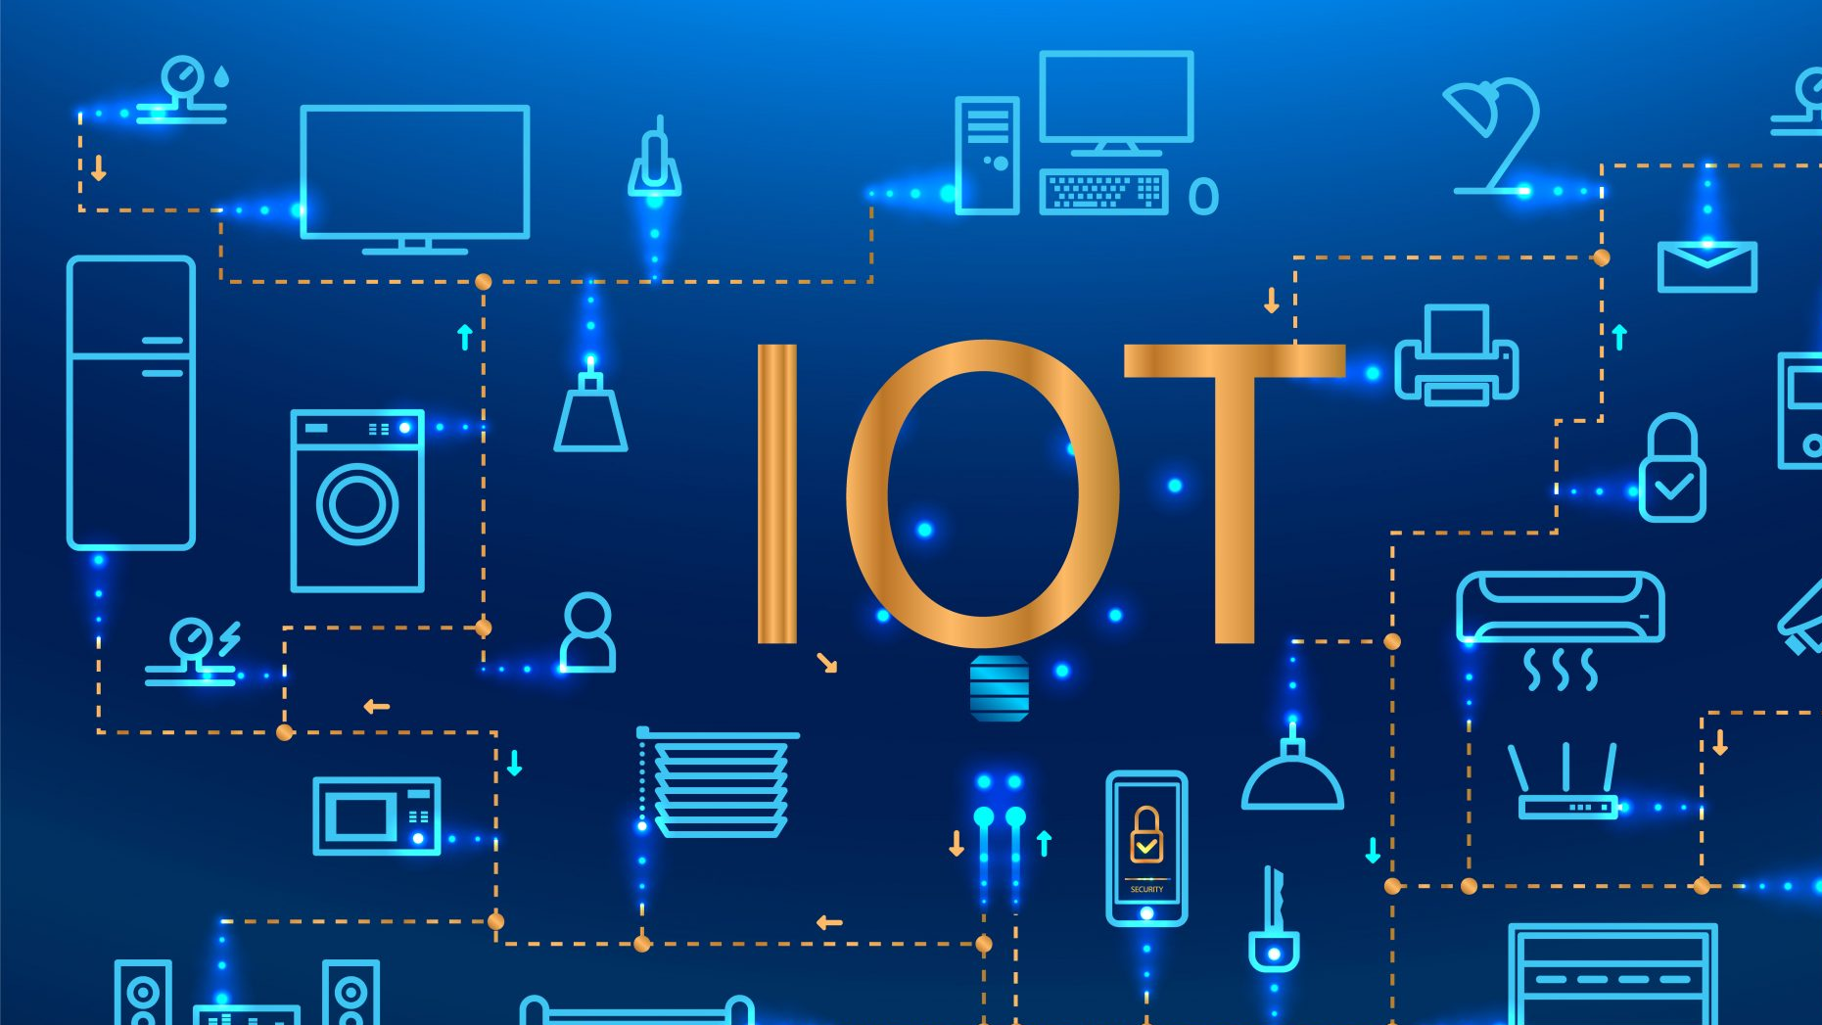
Internet of Things

Slide 2
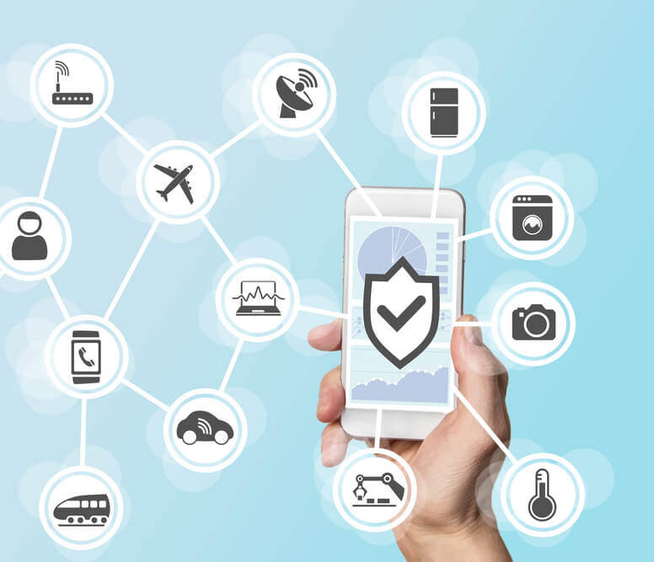
Internet of things
What are internet of thing?
How do we benefit from IOT?
What are the impact of IOT?
What is the history of IOT

Slide 3
Internet of Things
It is the interconnection via the internet of everyday devices enabling the user to send and receive data
The Internet of Things is increasing the connection of people ,materialistic things and animals to the internet. Alot of things are found on the internet and now even farmers can use the internet to track their animals if they got lost or if they sick. that info can help farmers make decisions easier.
The Internet of Things (IoT) is a system of interrelated computing devices, mechanical and digital machines, objects, animals or people that are provided with unique identifiers and the ability to transfer data over a network without requiring human-to-human or human-to-computer interaction.

Slide 4
Positive and Negative Impact of (IOT)
POSITIVES
NEGATIVES
Easy availability of illegal or inappropriate materials online that is not age suitable.
The use of internet to hack into people's accounts for stealing data or banking info.
Some use the internet to spread hate and terrorism.
Easy availability of illegal or inappropriate materials online that is not age suitable.
Some misuse the internet to spread hate and terrorism
Other use the

Slide 5
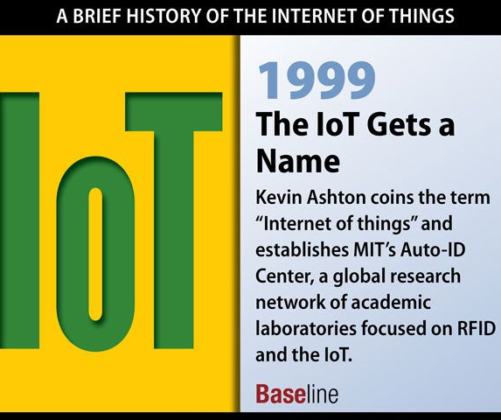
History of the Internet Of Things

Slide 6
REFERENCE
https://www.iotforall.com
https://www.cmswebsiteservices.com/blog/impacts-of-internet-of-things-on-society

